Slide 1
Hladni atomi rubidija u optičkoj rešetci
Lovre Kardum

Slide 2
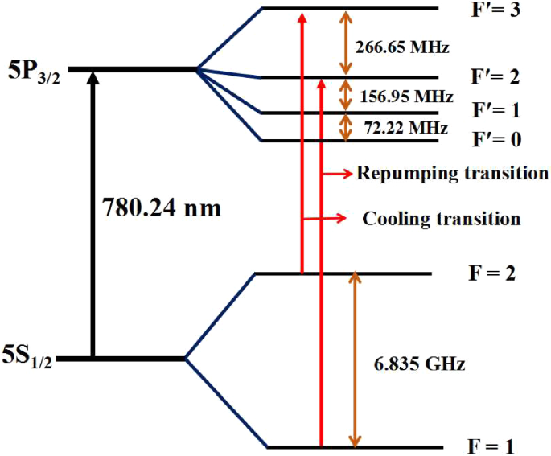
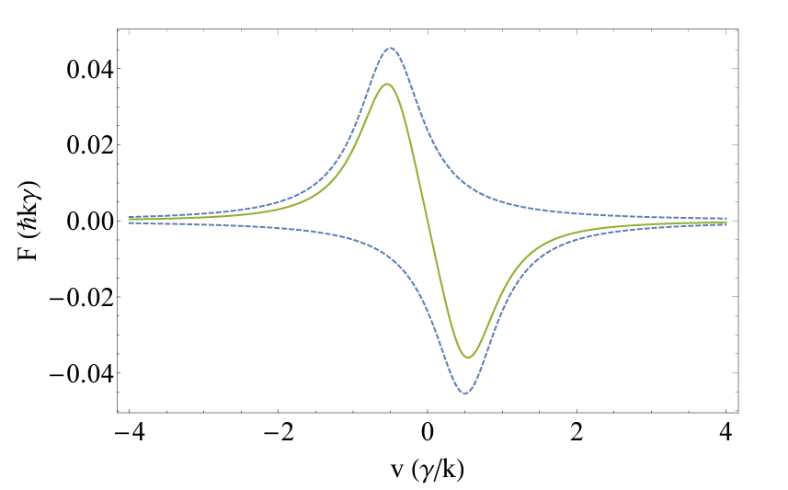
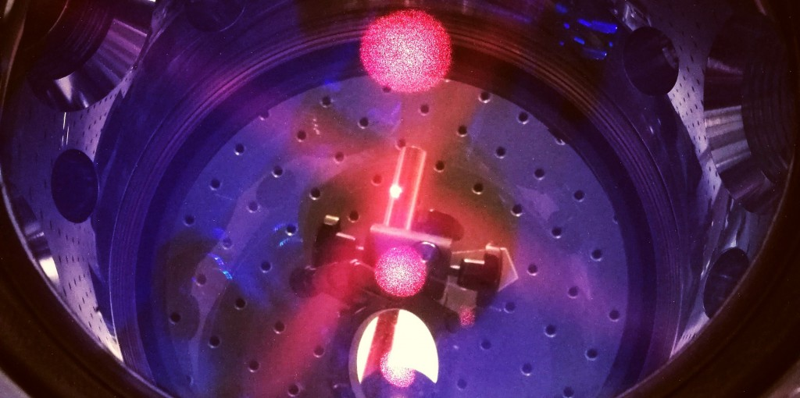
Magneto-optička stupica
Zašto rubidij?
S Singh, B Jain, S P Ram, V B Tiwari & S R Mishra: A Single Laser-operated Magneto-optical Trap for Rb Atomic Fountain
N. Šantić: Synthetic Lorentz Force for Neutral Cold Atoms
http://cold.ifs.hr/

Slide 3
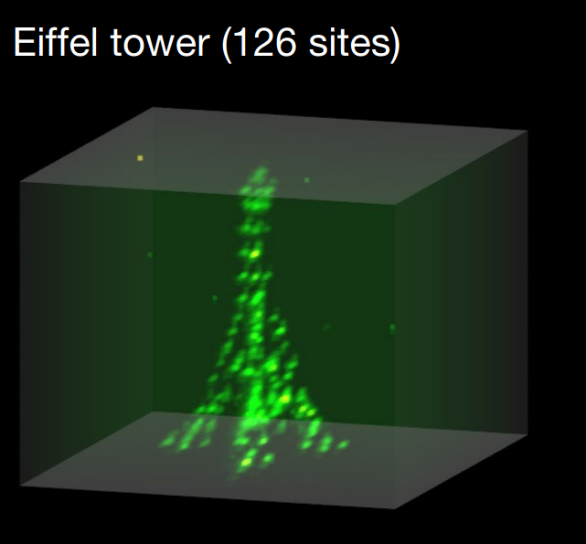
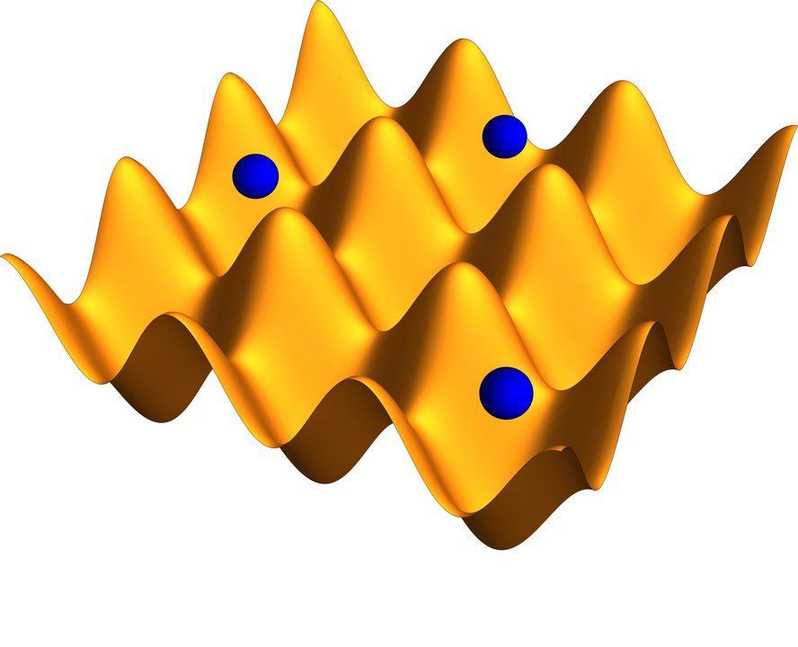
Dipolne zamke
Optička rešetka
Jedna zraka
2+ zrake
Daniel Barredo, Vincent Lienhard, Sylvain de Léséleuc, Thierry Lahaye & Antoine Browaeys: Synthetic three-dimensional atomic structures assembled atom by atom
https://en.wikipedia.org/wiki/Optical_lattice

Slide 4
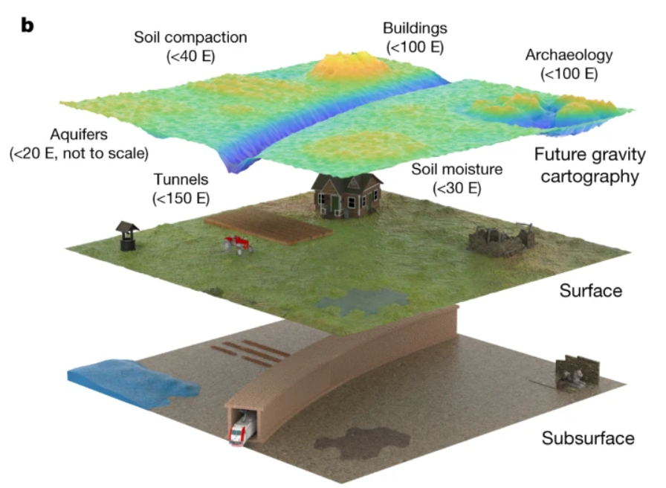
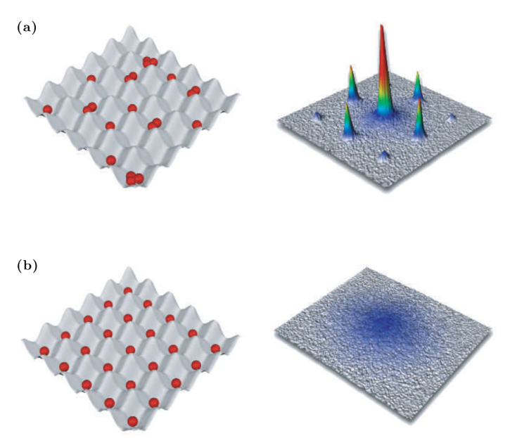
Upotreba:
Kvantna računala
Kvantni simulatori
Optički satovi
Atomska interferometrija – kvantni senzori
Philip H. Jones, Onofrio M. Maragò & Giovanni Volpe. Optical Tweezers: Principles and Applications
Stray, B., Lamb, A., Kaushik, A. et al.: Quantum Sensing for Gravity Cartography

Slide 5
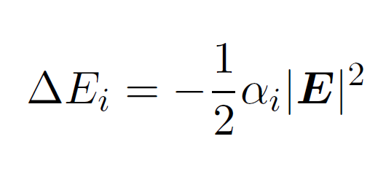
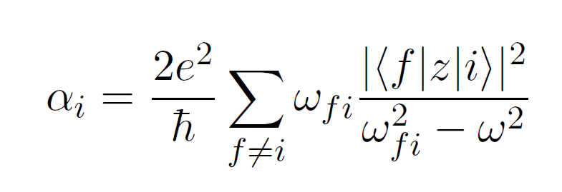
AC Stark efekt

Slide 6
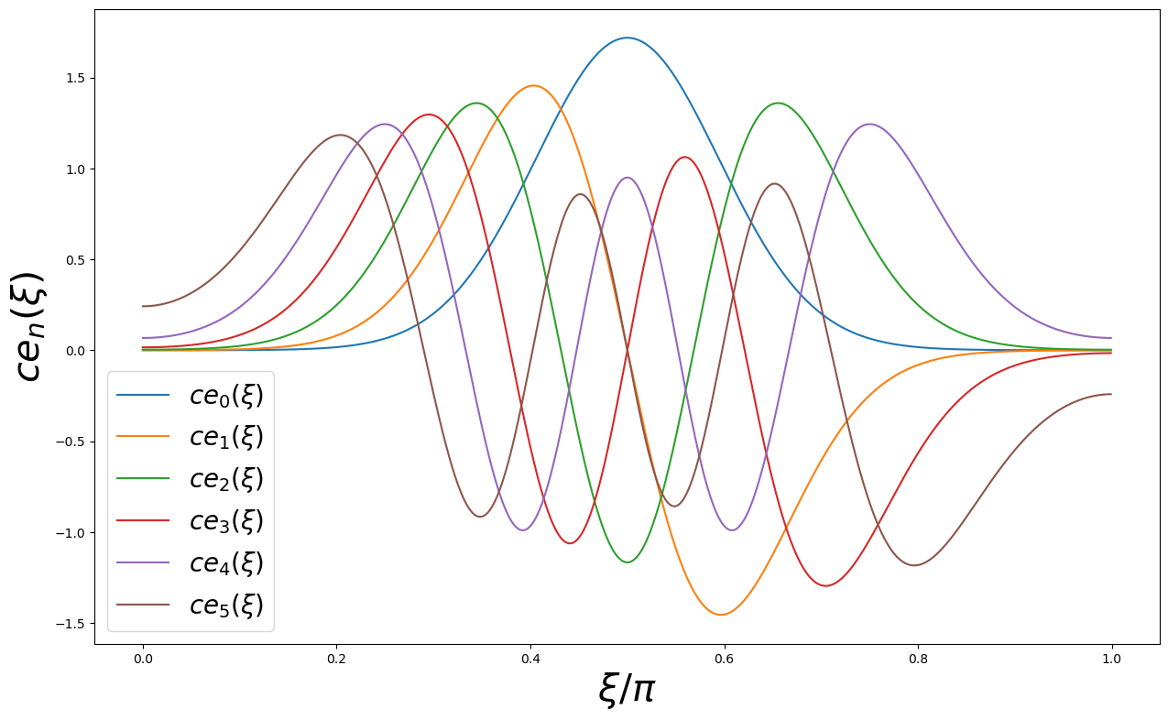
Valna funkcija

Slide 7
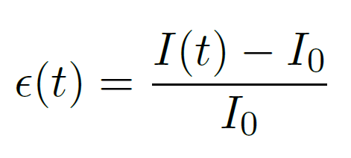
Amplitudni šum

Slide 8
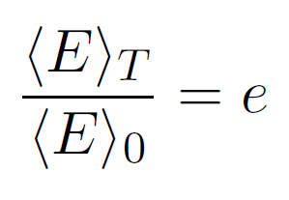
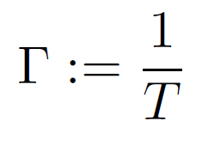

Slide 9
Mjerni postav: MOT
N. Šantić: Synthetic Lorentz Force for Neutral Cold Atoms

Slide 10
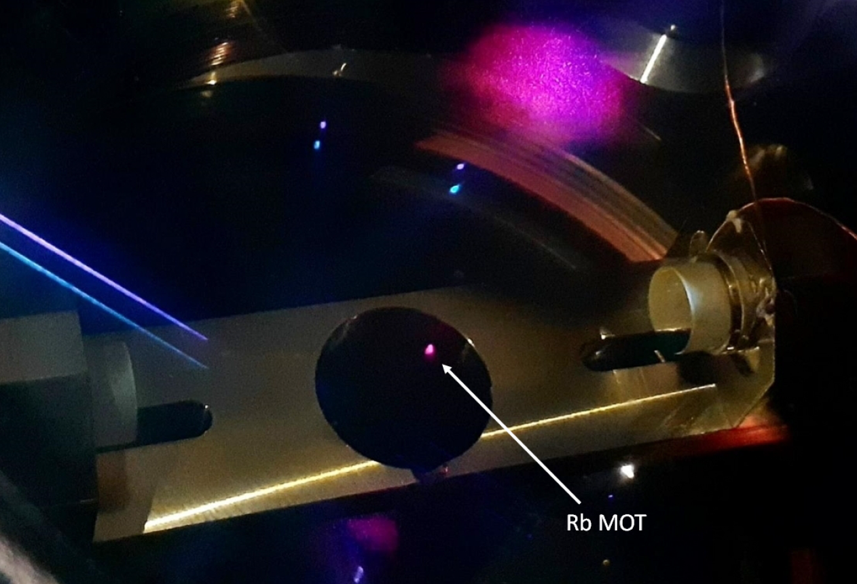
Optički rezonator
M. Kruljac: Cavity Cooling and Self-organization of Atoms Using an Optical Frequency Comb
Notes:
Snaga unutar cavitya
Problem što cavity pretvara frekventni šum u intenzitetski

Slide 11
Stabilizacija
Pound-Drever-Hall (PDH) metoda
PI kontroler
(eng. Proportional Integral )
M. Nickerson: A review of Pound-Drever-Hall laser frequency locking

Slide 13
$$T_{MOT}≈50 μK$$
$$V=230 μK$$

Slide 14
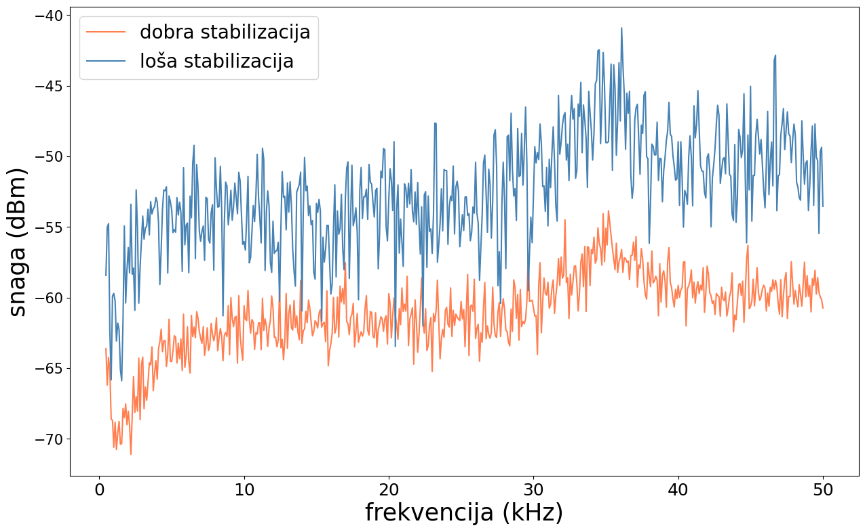
Spektar šuma

Slide 16
Vrijeme života
$$T_{d}=82 ±13 ms$$
$$T_{l}=43 ±2 ms$$

Slide 17
Hvala na pažnji!

